Slide 1
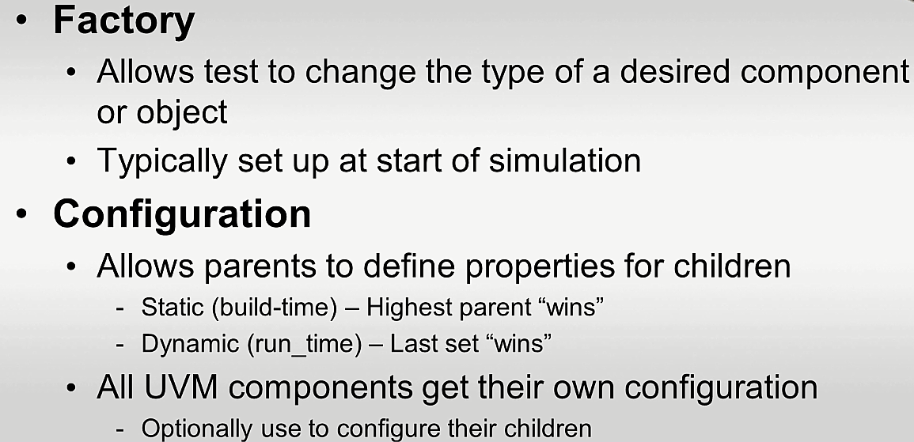
Two Customization Mechanisms

Slide 2
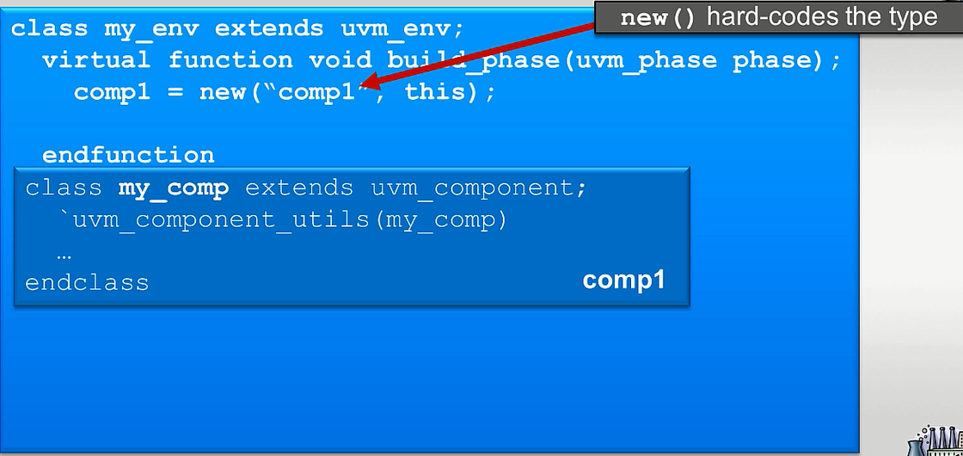
Create() vs new()
Notes:
In SV, when we have to instantiate an object, we have to construct it. The constructor function – new is used for this is SV, for which the name of the component and a pointer to the parent is provided.

Slide 3
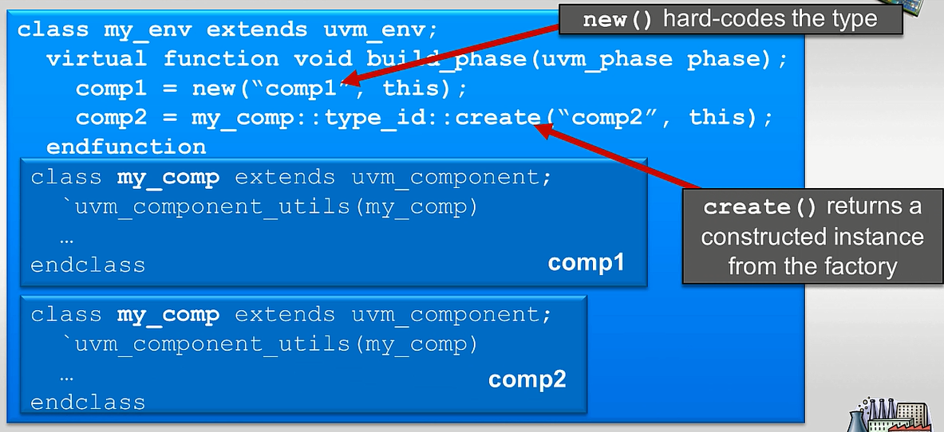
Create() vs new()
Notes:
In UVM, instead of using the constructor, create is used to get an instance of that component from the factory.
The wrapper allows us to get the required information out of the factory. The advantage of using factory is that it allows us to override the type of component that’s going to get returned by the wrapper.

Slide 4
Factory Methods
`uvm_component_utils(class_type_name) `uvm_component_param_utils(class_type_name #(params)) `uvm_object_utils(class_type_name) `uvm_object_param_utils(class_type_name #(params))
Registration
Examples
class packet #(type T=int, int mode=0) extends uvm_object; `uvm_object_param_utils(packet #(T,mode)) endclass
class monitor #(type T=int, int mode=0) extends uvm_component; `uvm_component_param_utils(monitor #(T,mode)) endclass
Notes:
Registration is required for name based overriding. It is not required for type based overriding

Slide 5
Factory Methods
Construction
To construct a UVM based component or object, the static method create() should be used.
This function constructs the appropriate object based on the overrides, if any, and returns it.
The create() function returns an instance of the component type T, subject to any factory override based on the context provided by the parent’s full name.
The context argument, if supplied, supersedes the parents context.
The new instance will have the given leaf name and parent.
static function T create(string name, uvm_component parent, string context = " ")
class_type object_name; object_name = class_type::type_id::create("object_name",this);

Slide 6
Factory Methods
Overriding
If required, user can override the registered classes or objects, based on name string or class-type.
For override by type, the override type is extended from original type.
The set_type_override() changes all instances of a class to a different class type.
The set_inst_override() changes specific instances of a class to a different class type.
For override by name, the original and override type names are class names that are registered in the factory.
When multiple overrides are done, by using the replace argument, we can control whether to override the previous override or not.
If replace is 1, then previous overrides will be replaced, otherwise, previous overrides will remain.

Slide 7
Factory Methods
Overriding
function void set_inst_override_by_type (uvm_object_wrapper original_type, uvm_object_wrapper override_type, string full_inst_path )
function void set_inst_override_by_name (string original_type_name, string override_type_name, string full_inst_path )
function void set_type_override_by_type (uvm_object_wrapper original_type, uvm_object_wrapper override_type, bit replace = 1 )
function void set_type_override_by_name (string original_type_name, string override_type_name, bit replace = 1)

Slide 8
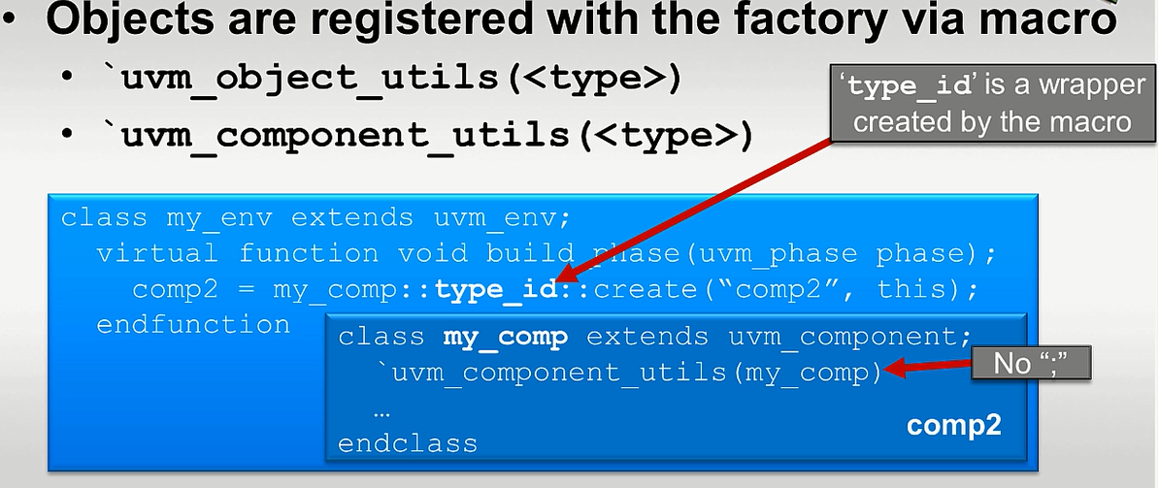
Registering with the factory
Notes:
`uvm_component_utils and `uvm_object_utils is used to register with the factory. These macros create the wrapper type to register the object/component with the factory to allow us to use create and other methods to access it from the factory.
The environment in the build phase will use the create call. The type_id is the wrapper that gets created by the macro

Slide 9
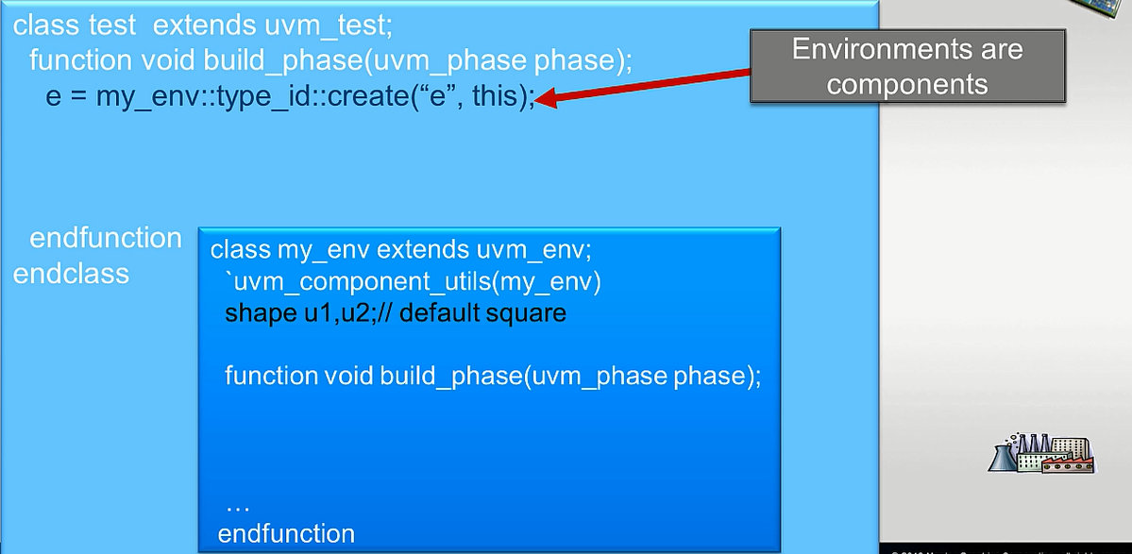
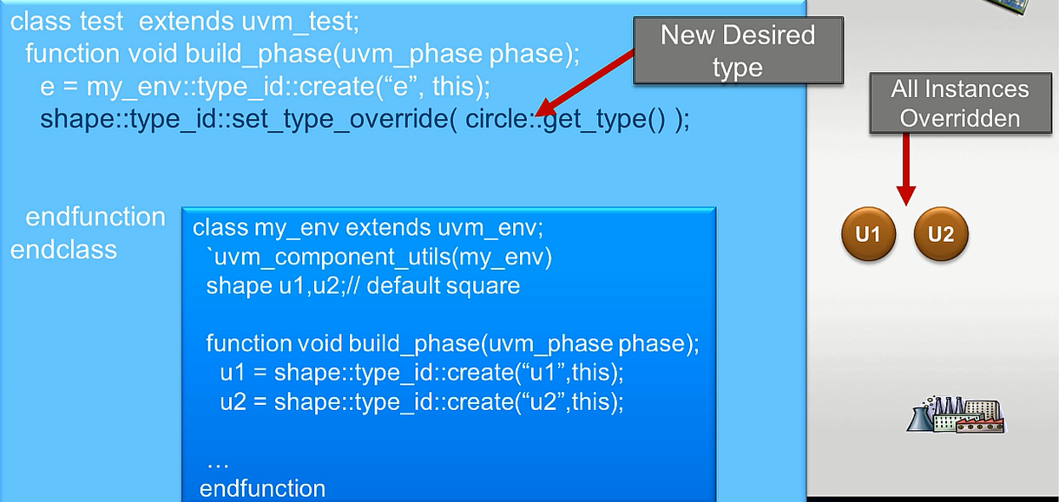
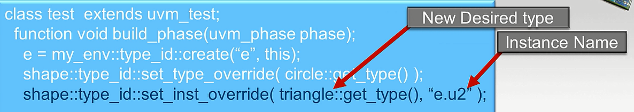
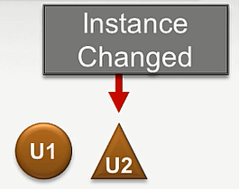
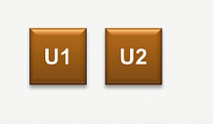
Overriding a type
Notes:
In this example, within the test, an instance of the environment is created. In this environment, two components u1 and u2 of type shape are instantiated. By default, these types are squares. The create method is used to create instance u1 and u2, thus giving two squares in the environment.
From the test, you can override the type, so instead of a square, you are going to get a circle. The environment code remains the same. The set_type_override overrides all instances of a given type.
You can also override a particular instance by set_inst_override. The type to be used is specified along with the instance name. In this example, instance U2 in the environment is now a triangle. In a series of overrides in the factory, the last override wins. In this case, the type of everything is override to a circle and then we override the type for instance U2 to be a triangle instead of the overridden circle.
If no instance override is found, the factory searches for a type override. Override searches are recursively applied, with instance overrides taking precedence over type overrides.

Slide 10
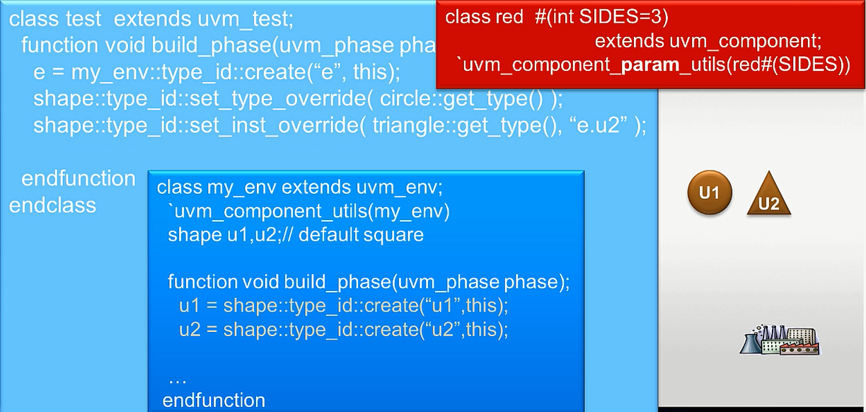
Using Parameterized Types
Notes:
Parameterized types can also be used with the factory. For a parameterized type red, with the parameter being the number of sides, this is registered with the factory using `uvm_component_param_utils along with the type and parameterization in the macro.
In the environment, the red component is instantiated as u3 and it is specified that it has 4 sides. This creates u3 which will be a red square.
From the test, you can even override the parameterized type. So, you may have an extension of red which is now blue, which by default uses the value of sides as 3.
In the test, you can then override any instance of a red 4-sided component to make it a blue 4-sided component, without changing the environment.

Slide 11
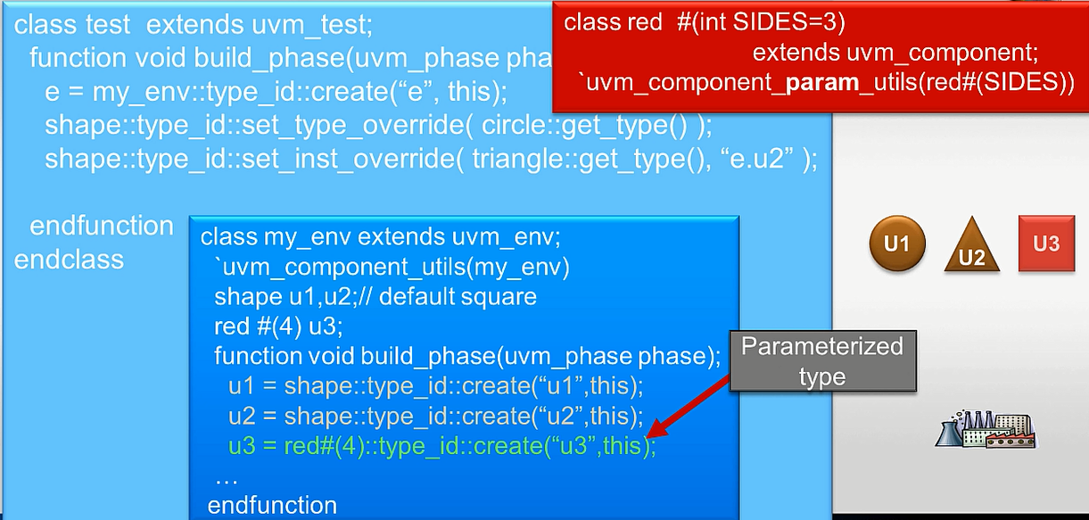
Using Parameterized Types
Notes:
In the environment, the red component is instantiated as u3 and it is specified that it has 4 sides. This creates u3 which will be a red square.
From the test, you can even override the parameterized type. So, you may have an extension of red which is now blue, which by default uses the value of sides as 3.
In the test, you can then override any instance of a red 4-sided component to make it a blue 4-sided component, without changing the environment.

Slide 12
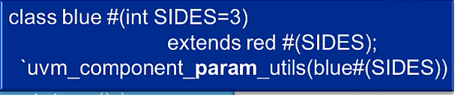

Using Parameterized Types
Notes:
From the test, you can even override the parameterized type. So, you may have an extension of red which is now blue, which by default uses the value of sides as 3.
In the test, you can then override any instance of a red 4-sided component to make it a blue 4-sided component, without changing the environment.

Slide 13
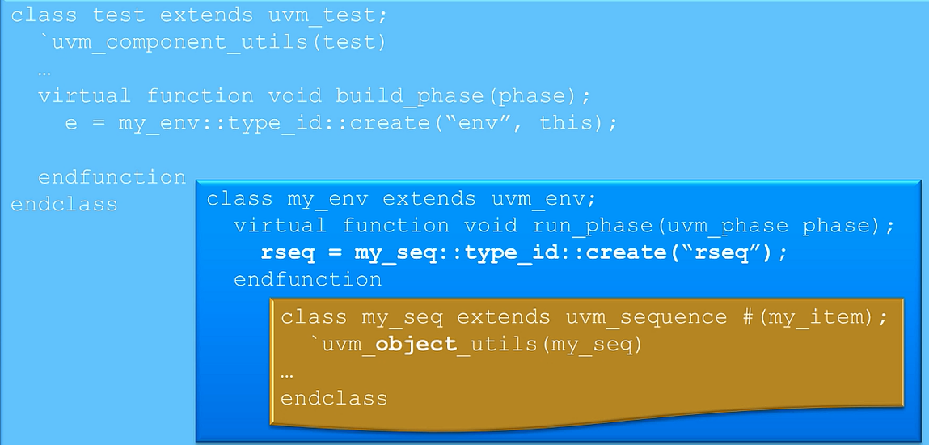
Use the factory for objects too
Notes:
Lets say the test instantiates an environment that in turn in its run phase creates a sequence of type my_seq. The sequence is registered with the factory using `uvm_object_utils.

Slide 14
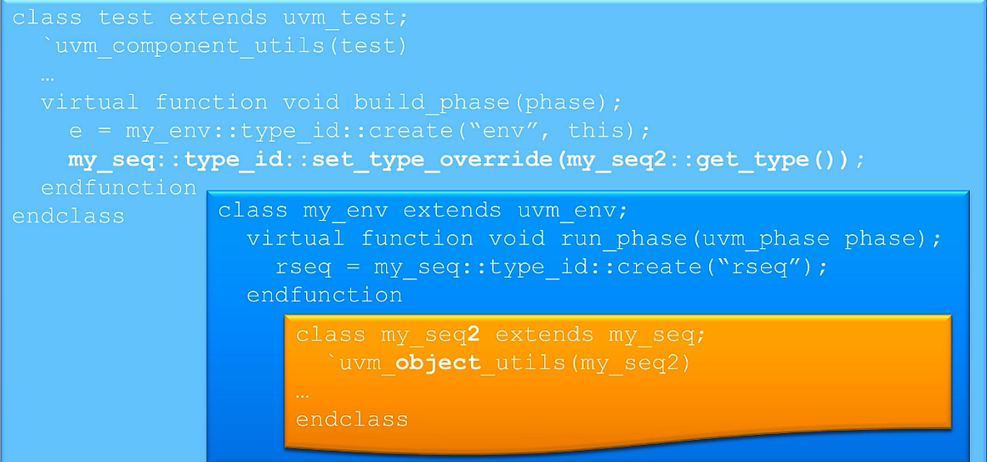
Use the factory for objects too
Notes:
From the test, you can override the type of that sequence to be a different sequence that’s extended from the same base type. So, at run time, the instance of the sequence provided will be my_seq2 instead of my_seq

Slide 15
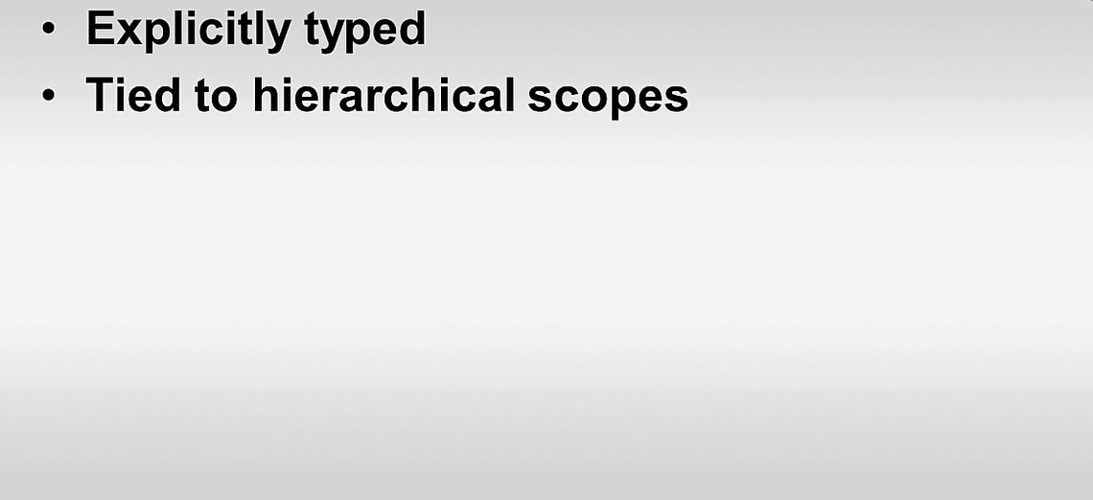
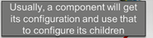
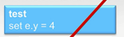
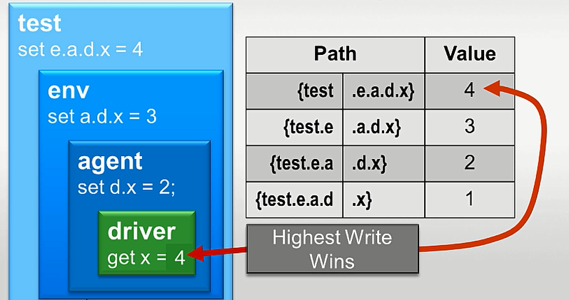
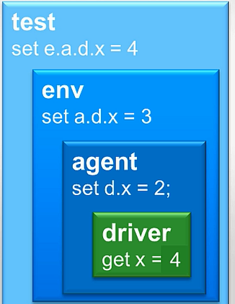
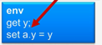
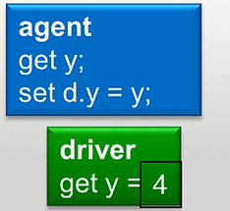
UVM Configuration Database
Notes:
UVM gives the central configuration database that allows components in higher level of hierarchy to configure variables in lower level components.
The other useful way to pass customization information down the hierarchy is through the configuration database. It is explicitly typed, so you don’t need to cast objects and it is tied to the hierarchical scoping in UVM.
Let’s consider a driver with a parameter type x that has a default value of 1. Then, there might be an agent that instantiates the driver and sets the value of x using the config database as 2, which will override the value specified by the driver. Similarly, values can be overridden at env and test levels. The value set at the highest hierarchy level will be the final value.
The set and get calls are used to affect the value of the driver. Since components get built in top-down manner in UVM, you cant actually set the value e.a.d.x from the build phase of the test, since the driver doesn’t exist yet. But, by using config_db, you can set the value you want to use and the driver gets the value once it’s actually been created.
Considering the path for the driver, it is set to be 1 directly. But the test sets the value as 4, which is the final value considered.
Usually in UVM, the first thing a component does in its build phase is to get its configuration from the config_db. It could be an integer or an object with all the configuration information it needs. In the example, the env gets the value of y from the config_db and uses that value to set the value of y inside the agent. The agent gets the value of y which it uses to set the value of the driver.

Slide 16
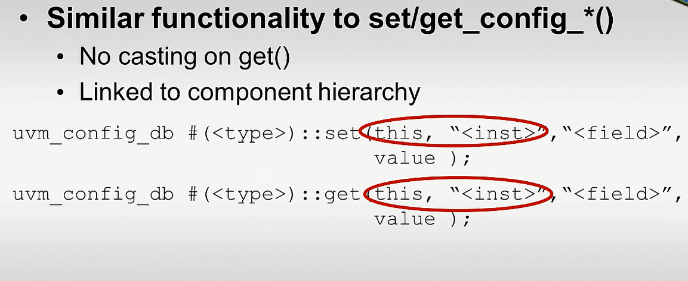
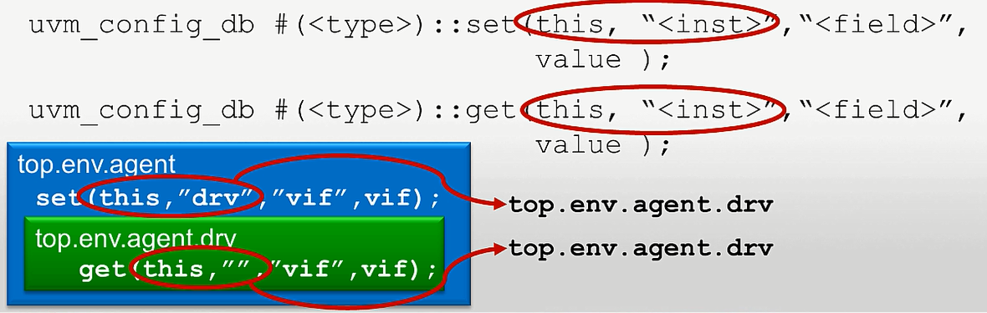
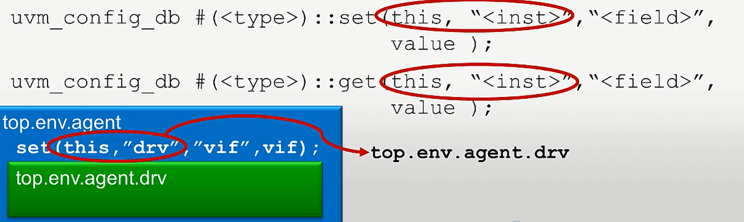
uvm_config_db
Notes:
While using config_db, it is parameterized with the type of value that is getting set. For set, the first argument is the component that is making the call, second argument is the instance name that you want to set relative to the component that is doing the set. The field name is also given that is set within the instance. This is followed by the value.
In get(), the instance name is usually empty string since ‘this’ pointer has full path name to the getting instance. As long as that path matches the call with the set, the information can be used. Since the uvm_config_db call is parameterized by the type of value that is returned, there is no need to cast the return value of the get call.
Passing a virtual interface pointer from tb_top to driver and monitor is a good example of config db use. In tb_top, user stores the virtual interface pointer using set function. In driver and monitor that needs access to DUT interface signals, which it can get using virtual interface pointer. It uses get function for this.

Slide 17
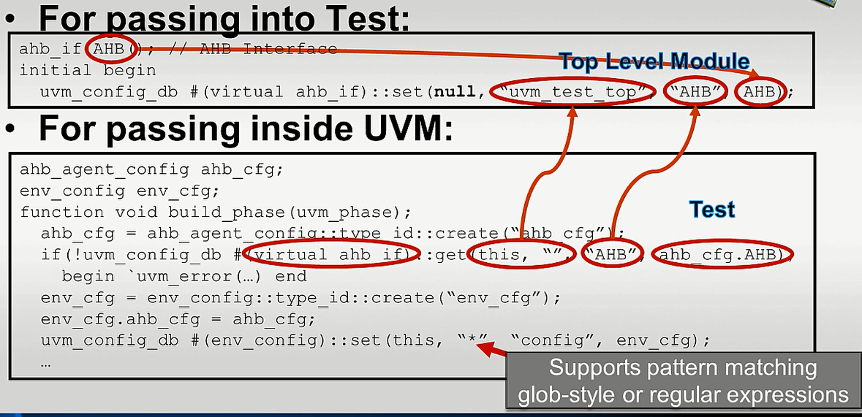
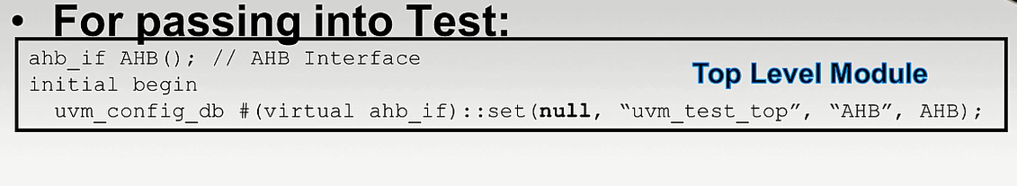
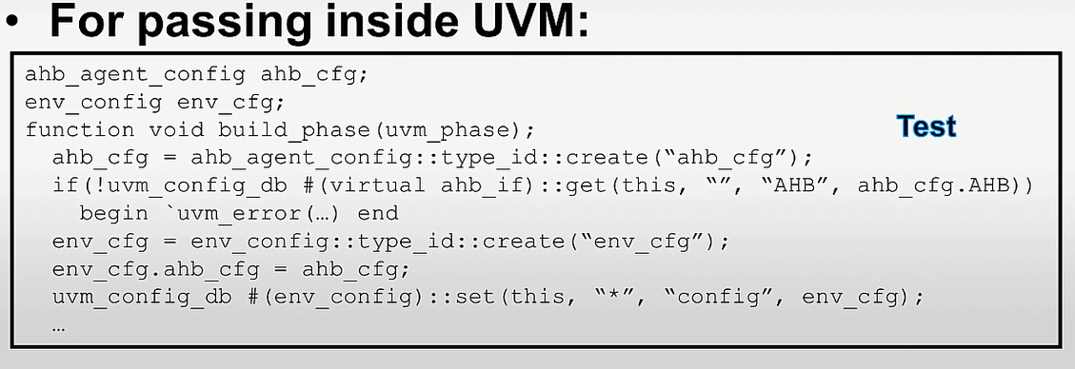
UVM Features-uvm_config_db
Notes:
One of the useful features of UVM is that it allows us to pass virtual interface handles from the top level module, down to the test, and down further into the environment and into the driver. So, at the top level, the config_db is used, parameterized by the type of virtual interface that you are going to set. The ‘this’ pointer is null since we aren’t going to class. This is followed by the path to the top level test instance, then the field name, and the interface that was instantiated in the top level module (AHB).
In the test, within the build_phase, we get the configuration information from the database. The get call is parameterized by the virtual interface type, ‘this’ pointer points to the uvm_test_top, the instance name isn’t necessary as it is incorporated in the ‘this’ pointer. This is followed by the field name we want to use(AHB), and the value of the desired field is returned in the last argument. The ahb_cfg.AHB is a config object that gets passed down hierarchically. The return of the get() call is 1 if successful and 0 if not.
The environment is created from the env_cfg object that is created from the factory. The env_cfg object will contain the ahb_cfg object, among other things. Then, the uvm_config_db set is called to pass the env_config down the hierarchy.
The instance name supports pattern matching using either glob-style or regular expressions. So, in this example, any instance that is looking for an item in the config_db called config that is of type env_config will be able to get our environment config object.

Slide 18
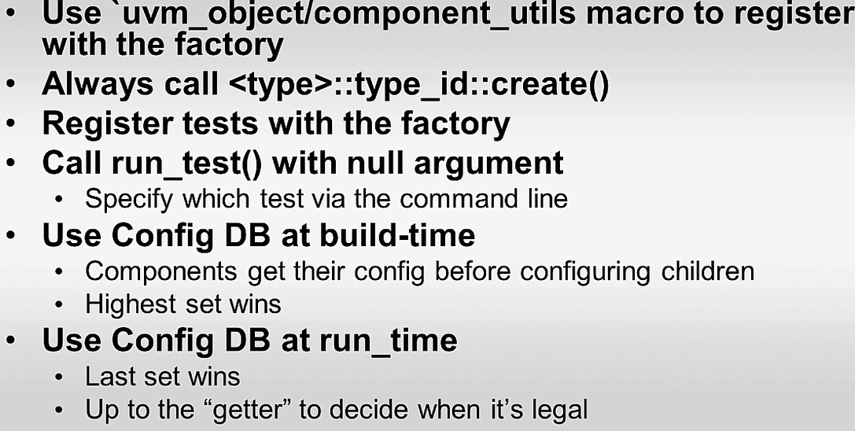
Summary
Notes:
Tests and all components are registered with the factory.
run_test is called without an argument in the top level module, the test passed in the command line fills the run_test
At build time, the config db is used so that every component can get its configuration from the db. Since everything in UVM is built in top-down, the highest component in the hierarchy wins..
You can also use the config db at run time. Let’s take the example of a driver that’s executing a state machine to interact with the bus. Everytime it gets to the IDLE cycle, that may be the time when it wants to get from the configuration database information (for example how many wait cycles to inject). It’s up to the getter to decide when it’s legal to get that information. The test won’t get into the driver every time and tell it to inject a different number of wait states when the driver is in the middle of executing a bus cycle. So, it’s upto the driver to know when it’s legal to update that value to get it from the config db. That allows the test to change the value in the database at any time, but the value will actually only change in the driver when it’s legal to do so.

